Slide 1

Agile & Scrum

Slide 2
Introduction

Slide 3
Why Agile?
Long term planning methodologies less supportive of projects currently done
Highly changing environment

Slide 4
Agile Alliance
Snowbird, Utah February, 2001
Created Agile Manifesto

Slide 5
Shift
Big up front design to iterative incremental development
Drive toward higher quality software in shorter time frames (MVP)
Requirements and solutions evolve through collaboration and self-organizing cross functional teams

Slide 6
The foundation of Agile is found at….
…. AgileManifesto.org

Slide 7
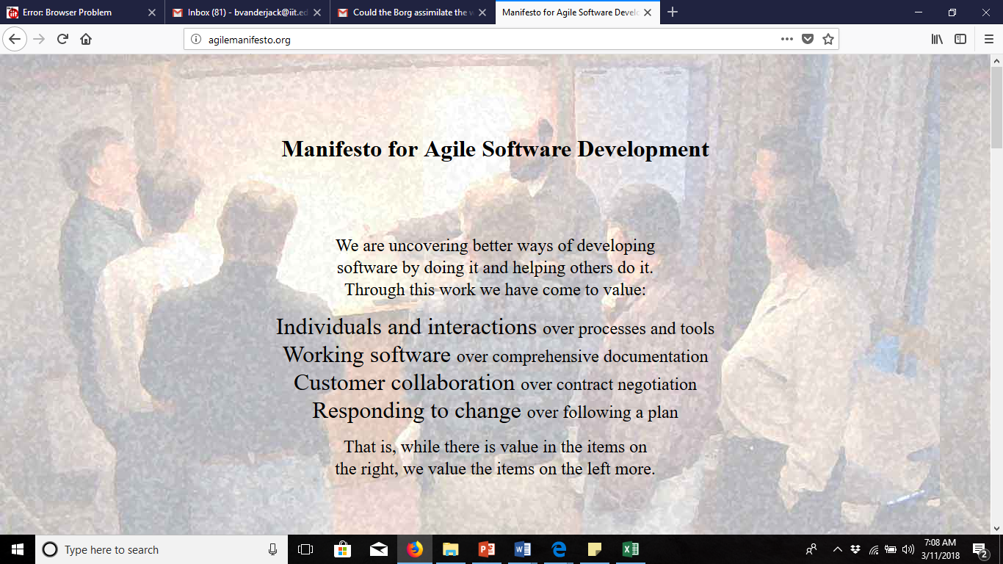
Class: Please memorize these values=>
Class: The word is “Over” not instead of…this is very important=>

Slide 8
Manifesto restatement
Individuals and interactions over processes and tools
Working software over comprehensive documentation
Customer collaboration over contract negotiations
Responding to change over following a plan

Slide 9
Principles Behind the Manifesto
Our highest priority is to satisfy the customer through early and continuous delivery of valuable software.

Slide 10
Principles Behind the Manifesto
Welcome changing requirements, even late in development. Agile processes harness change for the customer's competitive advantage

Slide 11
Principles Behind the Manifesto
Deliver working software frequently, from a couple of weeks to a couple of months, with a preference to the shorter timescale.

Slide 12
Principles Behind the Manifesto
Business people and developers must work together daily throughout the project.

Slide 13
Principles Behind the Manifesto
Build projects around motivated individuals. Give them the environment and support they need, and trust them to get the job done.

Slide 14
Principles Behind the Manifesto
The most efficient and effective method of conveying information to and within a development team is face-to-face conversation

Slide 15
Principles Behind the Manifesto
Working software is the primary measure of progress.

Slide 16
Principles Behind the Manifesto
Agile processes promote sustainable development. The sponsors, developers, and users should be able to maintain a constant pace indefinitely.

Slide 17
Principles Behind the Manifesto
Continuous attention to technical excellence and good design enhances agility.

Slide 18
Principles Behind the Manifesto
Simplicity--the art of maximizing the amount of work not done--is essential.

Slide 19
Principles Behind the Manifesto
The best architectures, requirements, and designs emerge from self-organizing teams.

Slide 20
Principles Behind the Manifesto
At regular intervals, the team reflects on how to become more effective, then tunes and adjusts its behavior accordingly.

Slide 21
Summary 12 principles (slide 1 of 2)
Customer satisfaction
Welcome changes
Frequent delivery
Work together
Motivated individuals
Face-to-face contact

Slide 22
Summary 12 principles (slide 2 of 2)
Working software
Constant/sustainable pace
Continuous attention
Simplicity
Self-organization

Slide 23
Empirical Process Control
Scrum is based on it
Transparency; the process itself and all communications
Inspection; Frequent inspection and the utilization of frequent reviews of the product service or results
Adaptation; embrace uncertainty and changes and manage risks accordingly
Empiricism involves learning and adapting as needed
Please memorize the three pillars of empirical process control.

Slide 24
Empirical Process Control
Iterative
Incremental
Frequent Reviews
Adaptation
Uncertainty and risks during execution
It isn’t a “defined” process; it’s a way of being and doing

Slide 25

https://www.scrum.org/resources/scrum-values-poster

Slide 26
Agile is an umbrella for…
XP
Scrum
Kanban
Others

Slide 27
Scrum Team Defined

Slide 28
Main Ideas about a Scrum team
Team is 7 +/- 2 members (optimally)
Cross functional
The “Team” owns the code base, specific programs are not ”owned” by a single person.
Product Owner provides User Stories on the Product Backlog and ranks them
Team Helps refine the product backlog
Scrum Master Coaches the entire team & removes impediments

Slide 29
Scrum Team has 3 parts (first of 3 slides)
Product owner
Scrum master
Team

Slide 30
Scrum Team: Product Owner (1 of 3)
Creates User Stories for the scrum team to work on.
Work with dev/test while revising User Stories on the backlog
Prioritize backlog (see next slide)
Approves:
work products as they complete
test plans
Explains User Stories to Dev/Test team (ongoing).
Negotiates User Story content when there are technical (or other) limitations
May actually execute the “demo” for all appropriate stakeholders

Slide 31
Prioritization of User Stories
The vison of the organization
Client’s immediate needs
NPV (if possible)
Story points of the User Story
Risks (to the team and to the business)
Perceived value of the User Story
Dependencies
Must have, Should have, Could have, Won’t have (MoSCoW)

Slide 32
Scrum Team (2 of 3): Development & Test
Team ownership of all code
Helps to refine user stories on backlog
Commits specific User Stories into Specific Iterations
Applies story points (by mutual consensus)
Has work approved by product owner as it completes – does not wait for “demo” at the end of sprint for approval.
Does the actual work:
Coding
All things related to Testing
May do environment support
Etc.

Slide 33
Scrum Team: Scrum Master (3 of 3)
“Servant leader,” not a project “manager” (see next slide)
Guide team toward Scrum thinking
Keep team moving in efficient manner
Keep team moving as one unit
Impediments
1) Coach team to remove impediments independently
2) Actually remove impediments (but avoids this to keep the team thinking “on their own,” and not dependent on the scrum master to the greatest extent.
Must be competent with respect to technology and application.
Ensure team logs hours and expected remaining hours into a software tool like Jira. (to make the burn down chart)

Slide 34
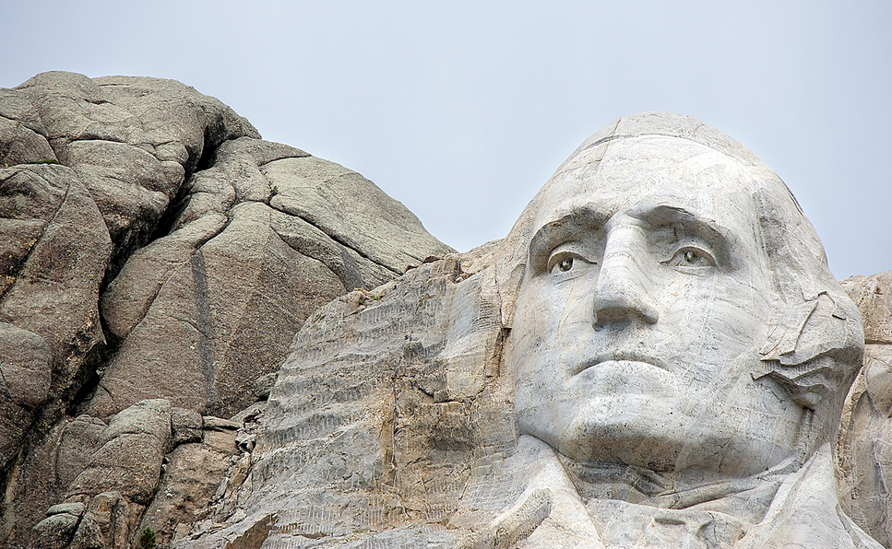
Scrum Masters are “Servant Leaders”
Defined: “The servant-leader is a servant first”
Mission: Continually “ensuring that other people’s highest priority needs are being served.”
Focus: “… the growth and well-being of people …”
ClipArt.com
https://www.greenleaf.org/what-is-servant-leadership/ No copyright claim by Vanderjack on this slide.

Slide 35
Scrum Masters are “leaders” not managers
See next 2 slides…

Slide 36

1
A Main Idea of Leadership…
…Leadership is based on a “Vision” of a better
tomorrow
ClipArt.com

Slide 37
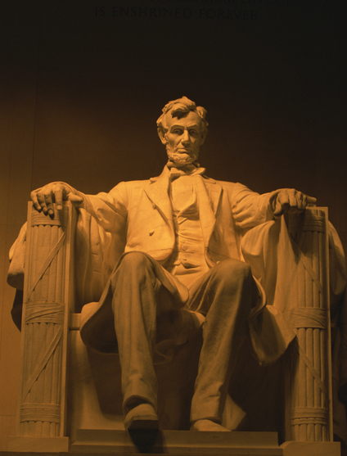
Leaders …
Inspire trust*
Focus on people*
Have, and share with their team members, the long-range vision
Associate the “vision” directly to the work the team is performing
ClipArt.com
* Inspired by Warren Bennis, as originally written in his best selling leadership book: “On Becoming a Leader”

Slide 38
Repositories & User Stories

Slide 39
2 User Story Repositories
Product backlog; all un-worked User Stories Start Here
Iteration backlog: The team pops work off the top of the prioritized backlog and puts the Uses Stories into the iteration-backlog.
Team members actually “commit” to the work before placing it in the iteration/sprint backlog.

Slide 40
Product Backlog
All User Stories start here
User Stories that are worked are selected from here, based on their priority, as assigned by the Product Owner
Low priority User Stories may never get done.

Slide 41
Refining the Backlog
The Team and the Product Owner work together to review and revise it; this is called backlog refinement
This process happens on a regular basis
Product Owner ranks and prioritizes User Stories based
organizational vision & mission
customer needs
MoSCoW
Comment: Low priority items may never get done

Slide 42
Iteration Backlog
Subset of the Product Backlog
What the Team commits to for this iteration
Iterations can last 1 week to 2 months, with a preference for shorter Iterations

Slide 43
User Stories Content (VERY IMORTANT – Likely on the Exam):
“As A,” “I Want,” “So That” format
Acceptance Criteria (what the product owner will be testing the User Stories for)
Meta data (who created the User Story, the date the User Story was created, the state of the user story*, etc.)
* This is how far along in the process the User Story is. As an example (only – the flow will be different in every company): Waiting, investigating, detail design, coding, unit testing, integrated testing, and approved by the Product Owner.

Slide 44
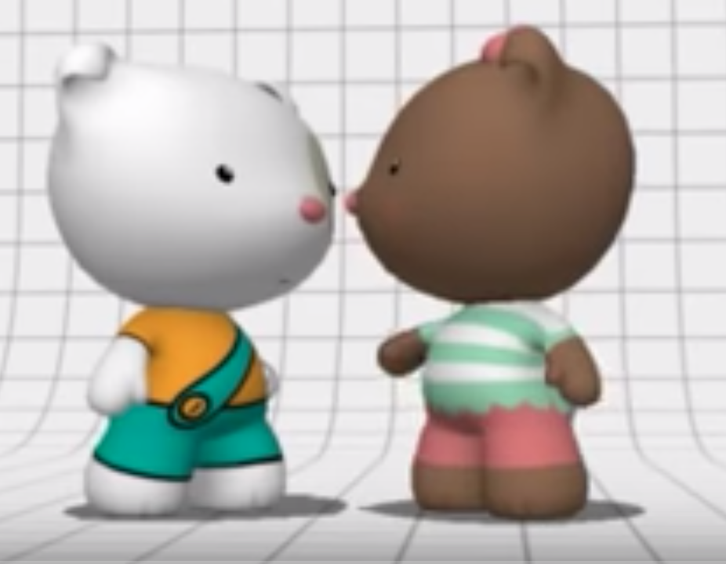
4 Things that compose a Story Point(derived from the video @
http://bit.ly/1sbfRfF
Relative size based on perceived:
Effort
Duration
Complexity
Risk

Slide 45
Story Points
The dev/test team mutually applies a story point estimate to all user stories, especially those that will likely be in the next iteration
A relative sizing of “user stories”
Modified Finocchi sequence: 0,1,1,2,3,5,8,13,20*,100*
The idea is from “20” and beyond, the User Stories are so big:
They should be decomposed
Rounding the story point value to “20” and ”100” gives the correct impression that the estimate is far from exact.
Here is a great video on story points: https://www.youtube.com/watch?v=qE5h6Q2lMsI
.* These numbers are near the official Finocchi sequence numbers, but not exactly.

Slide 46
Story Points: Why?
A history will be created as to how many story points a team actually works iteration over iteration
After about 3 iterations, a new scrum team should have a pretty good idea as to how much work they can safely take in, based on story points.
Once a team has an idea of how many story points it can take on during an iteration, this is called “Velocity”
Velocity, when used as a maximum amount of story points a team can commit to during an iteration, will keep people working at a sustainable pace, most of the time ☺
Scrum teams are to work at a “sustainable pace.” This means they can see their families because they are not working tons of over time all the time.

Slide 47
Burndown Chart
https://www.youtube.com/watch?v=GokN-50Jt4A. 3 Min
https://www.youtube.com/watch?v=rCY0XrSef1A 3 min

Slide 48
User Stories Observations
The duration of a User Story is always less than 1 iteration
User stories contain a lot of information
Refined by the team prior to committing them to an iteration
Prioritized by the Product Owner
* Following the Scrum cycle should be a habit. To learn more about forming habits you can read (optional):
https://amzn.to/2XG1QIT

Slide 49
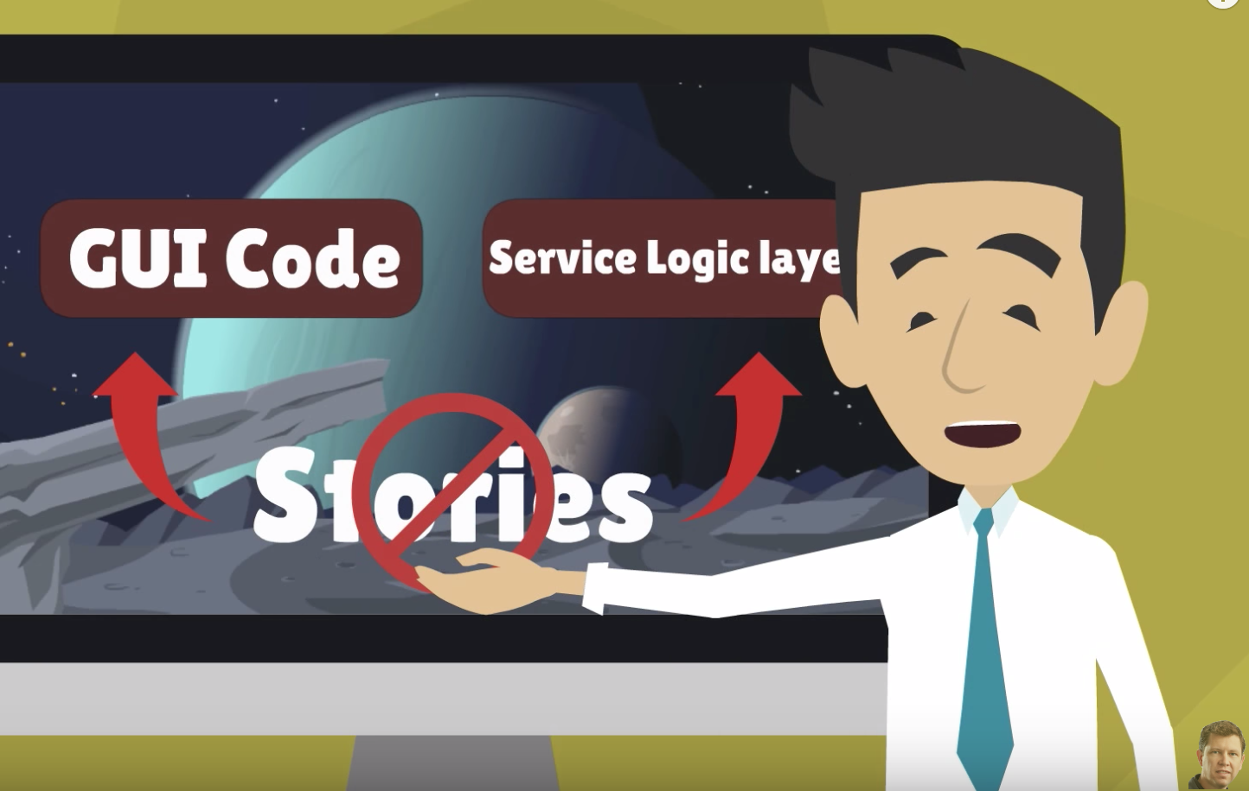
How to decompose User Stories (8 min)
https://www.youtube.com/watch?v=EDT0HMtDwYI

Slide 50
INVEST: A criteria for all User Stories
Independent
Negotiable
Valuable
Estimable
Small (At most, one iteration long)
Testable

Slide 51
Acceptance Criteria
Part of a User Story
Written by Product Owner or a tester and refined by the team during “Backlog Refinement”
Can easily be converted into test-cases
Every User Story has Acceptance Criteria

Slide 52
Agile Metrics
Commitments made/missed
Story points accepted vs velocity
Velocity trend
Scope changes during sprint
Resource utilization
Defect leakage
https://www.youtube.com/watch?v=tnhQmpIkGmk 17 min

Slide 53
The Scrum Process

Slide 54
Scrum
Team commits to User Stories: This creates
The “Iteration
Backlog”
© 2023 Brian Vanderjack
Product Backlog Handling
During Iteration commit Scrum team “pops” User Stories off of the top of the prioritized product backlog
Build Product
Backlog
Process The Product
Backlog
Product Owner(PO) creates User Stories to support Business Needs
Dev/Test Team
Assigns Story
Points
Backlog
Refinement (by dev/test)
New User Stories to get unfinished work from previous iterations done.
PO prioritizes Product Backlog
Product
Backlog
(queue)
Defects

Slide 55
Scrum
© 2023 Brian Vanderjack
Iteration
(scrum cycle)
Product Backlog Handling
Code/Unit Test
Build Product
Backlog
During Iteration commit Scrum team “pops” User Stories off of the top of the prioritized product backlog
Miscellaneous post-unit-testing like: Integration Testing,
Capacity Testing,
Regression Testing, etc.
PO creates User Stories to support Business Needs
Team commits to User Stories: This creates
The “Iteration
Backlog”
Daily Stand
Up
Process Product
Backlog
New USs to get unfinished work from previous sprints done.
Dev Team
Assigns Story
Points
Product Owner approves
Work products (ASAP)
Retrospective
Backlog
Refinement (by dev/test)
Demonstration
Deploy working into Production ASAP
(not linked to Scrum cycle)
Product
Backlog
(queue)
Key
US =User Story
PO = Product Owner
PO prioritizes Product Backlog
Defects

Slide 56
Integration Events: Demonstration
Once per iteration
It is a time to:
Show off all the completed work to the Product Owner at one time
Get any last minute approvals
Product owner could get some new ideas
It is best if the Team holds a practice Demonstration before the actual Demonstration to work out any last minute kinks before the Product Owner sees them at the actual Demonstration
This may stimulate new ideas in the Product Owner’s mind.
Time boxed

Slide 57
Iteration Events: Daily Standup (DSU)
Daily
Same time
Same duration 15 minutes Daily Stand Up + 15 minutes for issues
Can schedule to meet at another time for more involved issues
The agenda for each person is: “What I did yesterday”/”What I’ll do today”/”Any impediments”
For a face-to-face environment, team members actually stand for the entire DSU
Keeps everyone up to date as to what the team is doing (transparency)

Slide 58
Iteration Events: Retrospective
What went right
What could be improved next time
Best if improvement items are within team’s control
Good focus points: Quality, scope, relationships, commitments (kept and missed), processes, tools etc.
Should NEVER be used to punish people for mistakes!

Slide 59
Definition of “Done” & “Done-Done”
The team defines what done (a complete) user story is, in their social contract*. Typically this will mean the coder and tester have completed their work, and the product owner has approved it.
“Done – Done” typically means the User Story was accepted by the product owner, and, delivered into production.
Typically related to approval of acceptance criteria in User Story by Product Owner
*Good Scrum Teams create a “social contract” for themselves. It defines their social norms (how they behave with respect to each other), coding standards, conflict negotiation process, etc.

Slide 60
Scaling Scrum & Kanban

Slide 61
Scrum of Scrums
Typically attended by scrum masters (but others are invited as needed)
This is the first layer and simplest way to start scaling Scrum.
Dependencies between Scrum Teams are discussed and resolved
Deal with issues that are faced by more than 1 team on an effort
Typically weekly or 2*week
Track cross-team impediment resolution

Slide 62
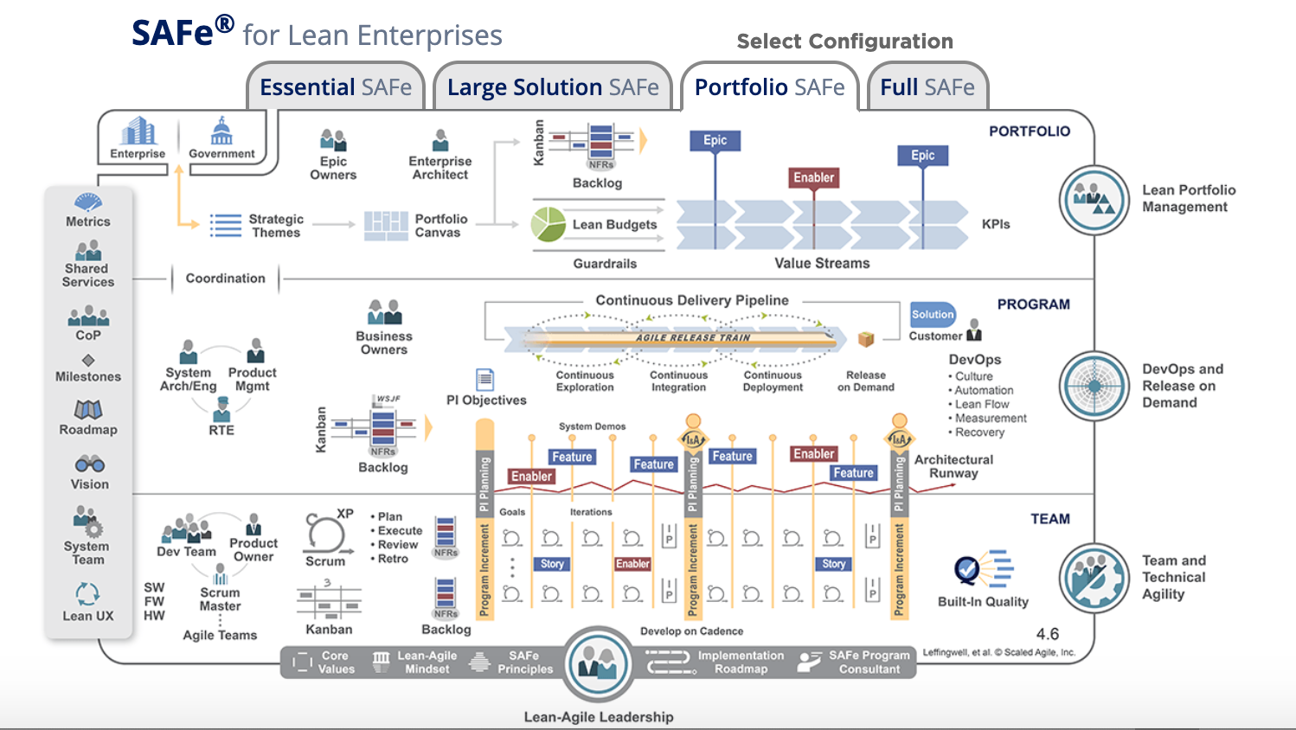
Scaled Agile Framework (SAFe) (never on any exam in this course – it is a multi-day training class to understand SAFe)
ScaledAgileFramework.org

Slide 63
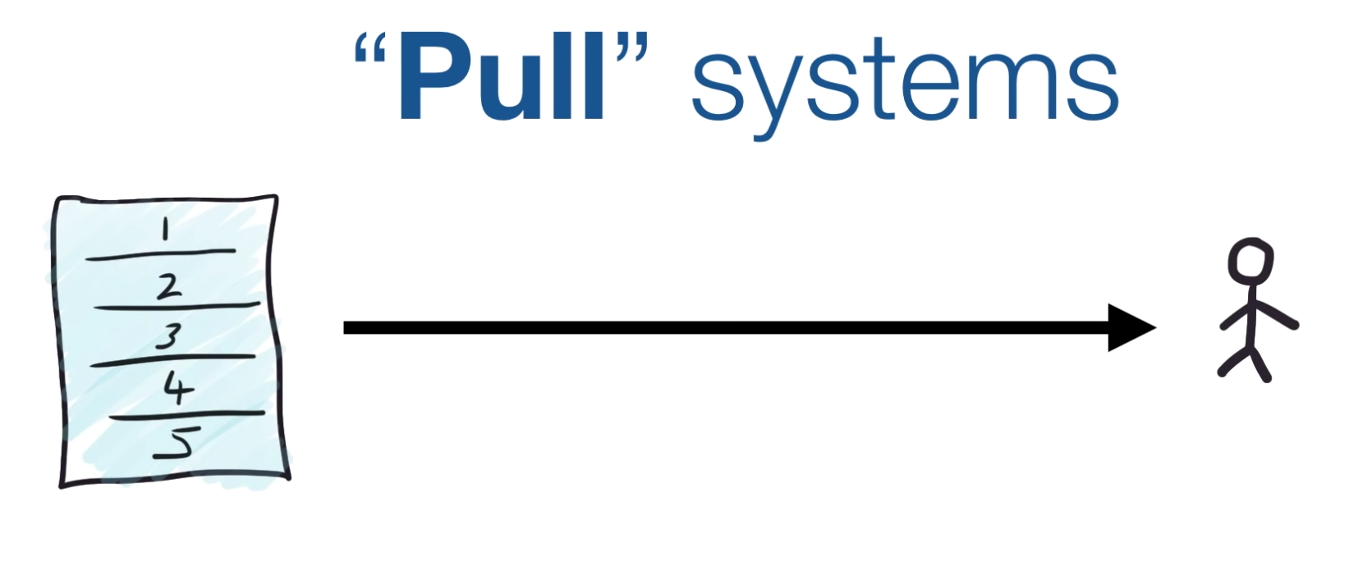
Kanban
https://www.youtube.com/watch?v=rIaz-l1Kf8w (.5 M Views/5 min)
https://www.youtube.com/watch?v=iVaFVa7HYj4. 7 minutes (excellent)
https://bit.ly/33Gf5Ny 2.5 minutes
https://bit.ly/2UyzXlN 7.5 minutes

Slide 64
What in Jenkins (just watch the first 4 minutes)
https://bit.ly/2QGqwzK

Slide 65
Done-Done ☺

Slide 66
What is ScrumBan?
https://www.youtube.com/watch?v=fgT4AaKcBUA

